Slide 1
The Effect of Early Exposure to Pollution on Later in Life Health Outcomes
Cornelia Ilin*, Dan Phaneuf**
AERE 2020
June 3-5, 2020
* UC-Berkeley, ** UW-Madison

Slide 2
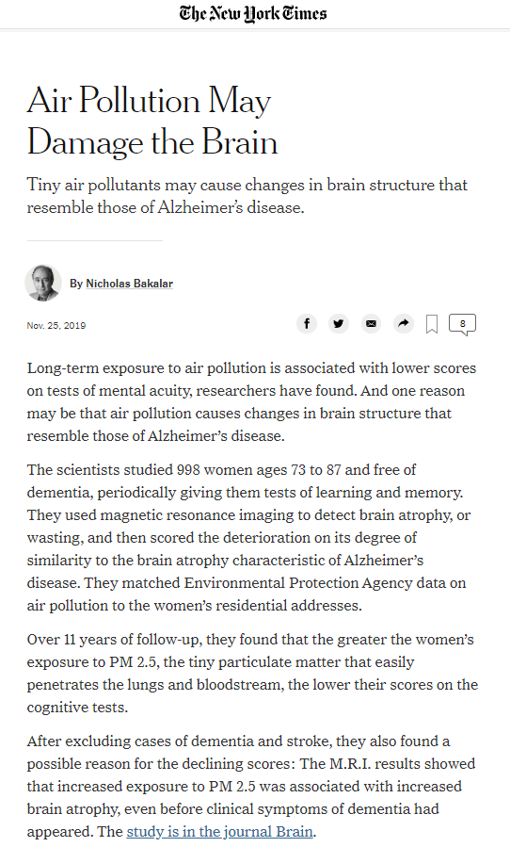
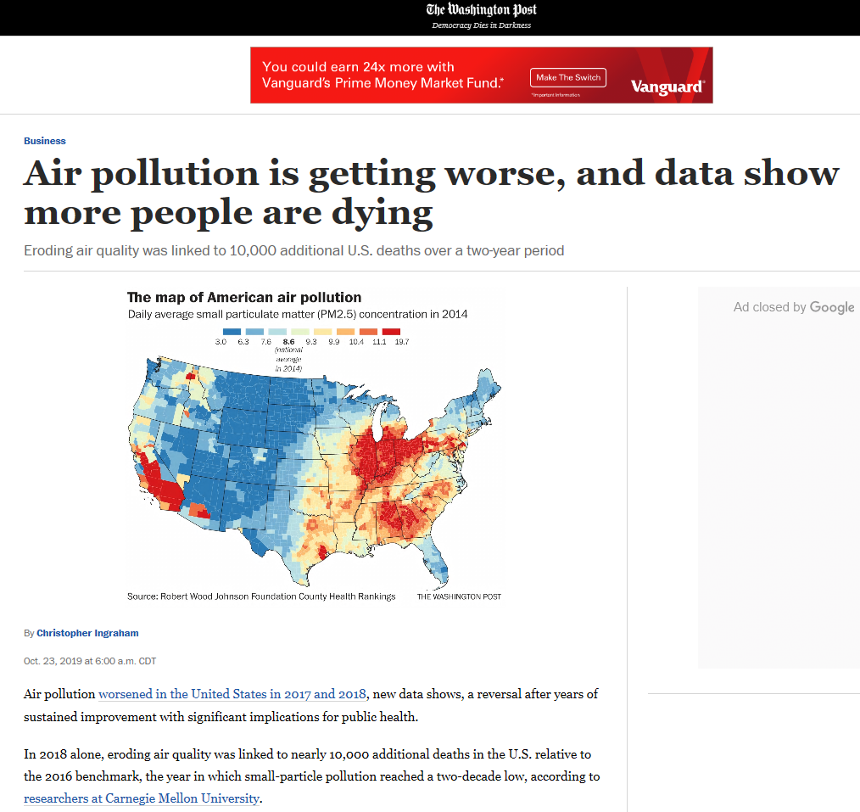
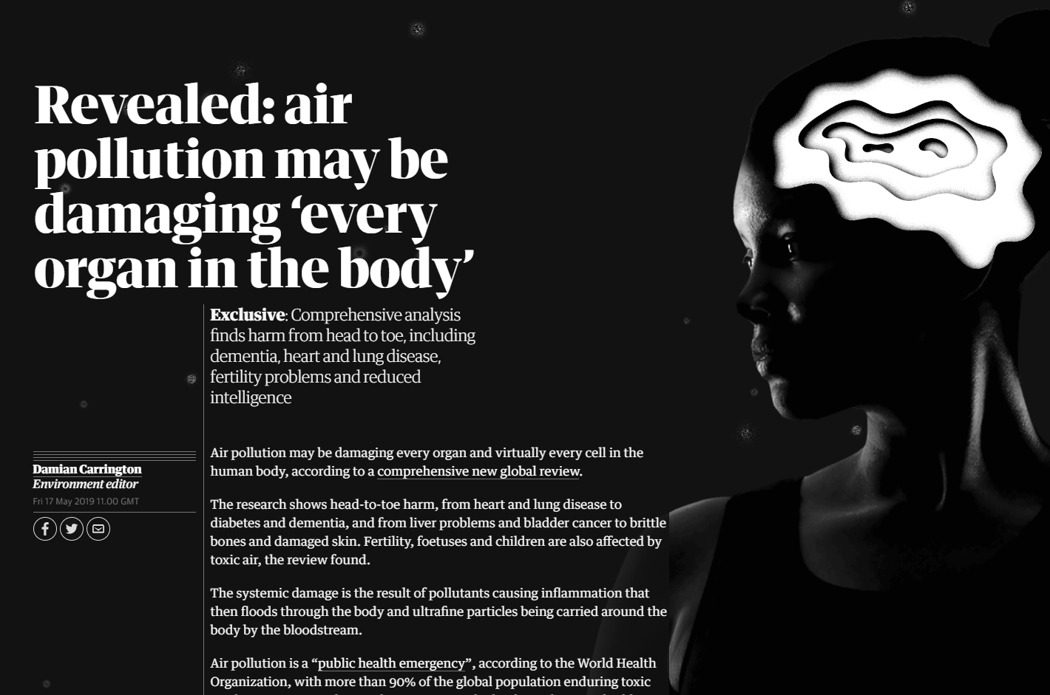
Motivation
The Guardian, 17 May 2019

Slide 3
PM 10 are eliminated through coughing, sneezing
PM 2.5 can travel deep into the lungs, causing head-to-toe harm
PM particles enter the human body through nose and mouth
Source: The Guardian, article published on May 17, 2019;
https://www.theguardian.com/environment/ng-interactive/2019/may/17/air-pollution-may-be-damaging-every-organ-and-cell-in-the-body-finds-global-review

Slide 4
Literature
health
short term
early childhood
e.g. Chay and Greenstone (2003a,b); Currie and Neidell (2005); Sanders and Stiecker (2011)

Slide 5
Literature
health
short term
late childhood
e.g. Neidell (2004); Schlenker and Walker (2005); Austin, Phaneuf et al (2018); Obradovich et al (2018)

Slide 6
Literature
health
short term
adulthood
e.g. Neidell (2004); Schlenker and Walker (2005); Austin, Phaneuf et al (2018); Obradovich et al (2018)

Slide 7
Literature
capital accumulation
long term
early childhood
late childhood
e.g. Reyes (2007); Sanders (2012); Isen et al (2017); Voorheis (2017)

Slide 8
Literature
labor market
long term
early childhood
adulthood
e.g. Reyes (2007); Sanders (2012); Isen et al (2017); Voorheis (2017)

Slide 9
Our contribution
health outcomes
long term
early childhood
adulthood
no missing middle
How early in life pollution exposure affects later in life health outcomes?

Slide 10
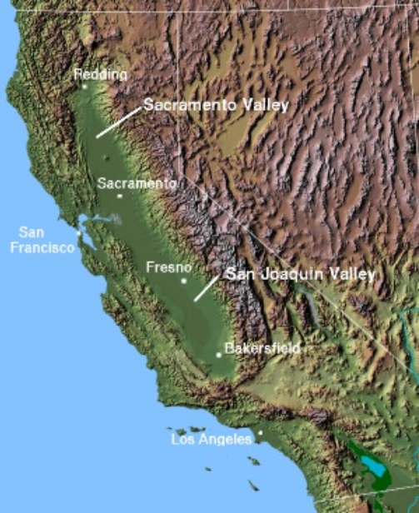
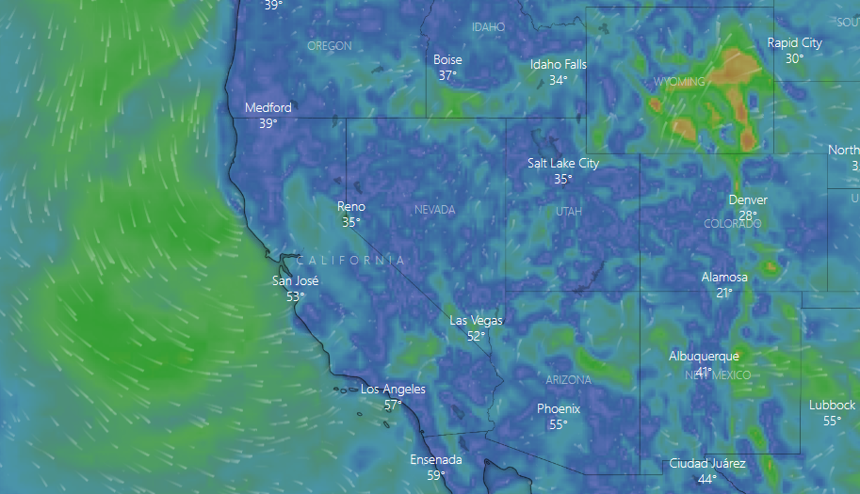
Data - location
More stringent regulations
Pollution is trapped
Geography
California, US
Wind direction
Winds coming from the Pacific Ocean
Mountainous terrain
Source: windy.com; website accessed on May 27, 2020; https://www.windy.com/?2019-12-12-00,36.635,-98.965,5
Source: Wikipedia; website accessed on May 27, 2020; https://en.wikipedia.org/wiki/Central_Valley_(California)

Slide 11
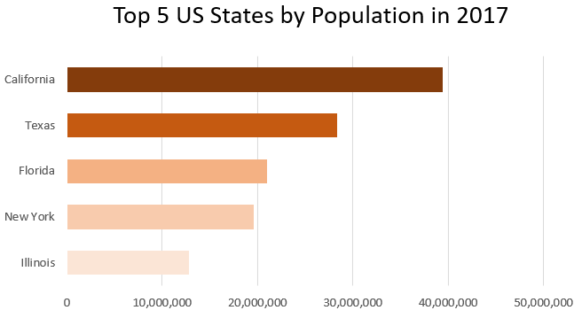
Data - location
More stringent regulations
Pollution is trapped
Geography
California, US
Wind direction
Winds coming from the Pacific Ocean
Mountainous terrain
Population rank: 1 (since 1970)
Source: US Census Bureau, accessed on May 27, 2020; https://www.census.gov/data/tables/time-series/demo/popest/2010s-state-total.html

Slide 12
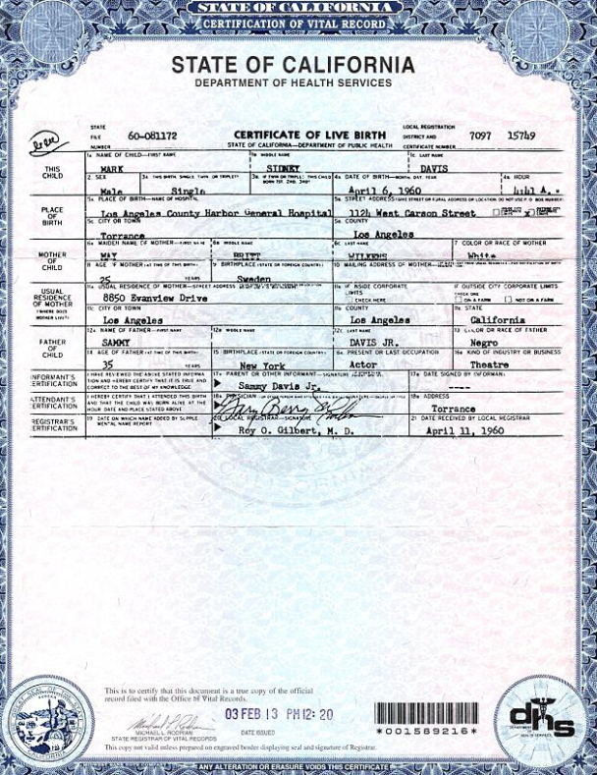
Data - sources
Health: restricted access (HIPAA protected patient level data)
maternal hospital records
+
Vital statistics birth certificate data (CDPH)
1991
2012

Slide 13
Data - sources
Health: restricted access (HIPAA protected patient level data)
Hospital discharge data (OSHPD)
Vital statistics birth certificate data (CDPH)
1991
2012
2017

Slide 14
Data - sources
Health: restricted access (HIPAA protected patient level data)
Emergency room data (OSHPD)
Hospital discharge data (OSHPD)
Vital statistics birth certificate data (CDPH)
1991
2005
2012
2017

Slide 15
Data - sources
Health: restricted access (HIPAA protected patient level data)
Emergency room data (OSHPD)
Hospital discharge data (OSHPD)
Vital statistics birth certificate data (CDPH)
1991
1998
2005
2012
2016
2017
Satellite PM 2.5 data (NASA)
Pollution: public access

Slide 16
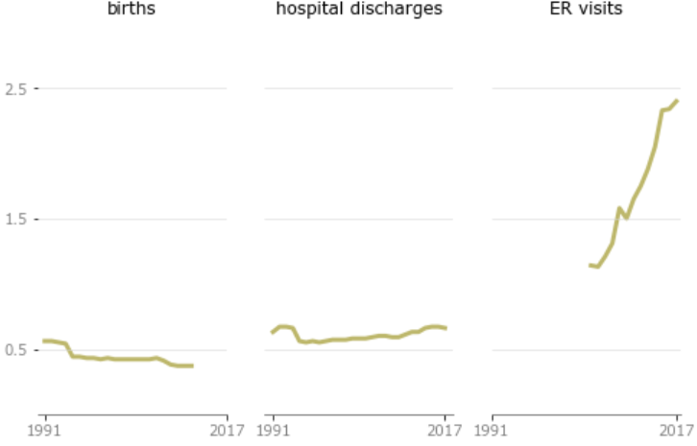
Data - stats
numbers (in millions), patients born after 1991
health conditions: all
births
hospital discharges
ER visits
total = 9.24
total = 16.4
total = 22.3

Slide 17
Data - stats
numbers (in millions), patients born after 1991
health conditions: all
health conditions:
respiratory, cardiovascular & accidents, injury
births
hospital discharges
ER visits
total = 9.24
total = 16.4
total = 22.3
total = 6.78
total = 0.84

Slide 18
Data – the issue of patient record linkage
Goal for analysis: identify which patients in the Hospital/ER DB refer to the same entity in the Birth DB?
Birth DB
SSN link = 3%
SSN link = 3%
Hospital DB
ER DB

Slide 19
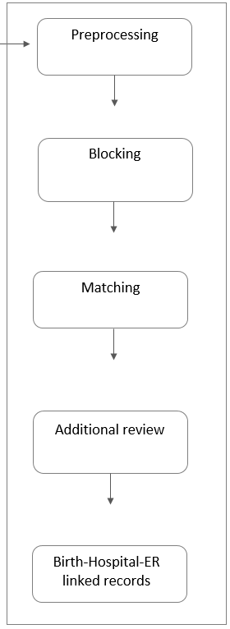
the issue of patient record linkage
Blocking

Slide 20
the issue of patient record linkage
Blocking
Matching

Slide 21
the issue of patient record linkage
Blocking
1
AA
12
AA
7
Matching
Allow for patient characteristics to change over time (through SSN, or diagnosis history when SSN is not present).
$$≠$$
Traditional record linkage
Recognize that the age at which birth and patient attributes match can provide important clues.

Slide 22
the issue of patient record linkage
Blocking
x
1
AA
x
12
AA
7
Matching
Allow for patient characteristics to change over time (through SSN, or diagnosis history when SSN is not present).
$$≠$$
Traditional record linkage
Recognize that the age at which birth and patient attributes match can provide important clues.
{b1}: {r2, r3}

Slide 23
Regression model
may be related to pollution
(birth or contemporaneous exposure)
$$Y_{it}=βP_{cb}+γX_{i}+θ_{jt}+δ_{c}+ε_{it}$$
hospital/ER visit by person i on a specific date t
What is the number of hospital/ER visits for these 4 conditions combined over time and across states?

Slide 24
Conclusions
Early exposure to pollution has a positive effect on later in life health outcomes.
Next steps:
Consider agreement- and disagreement decay ML models for matching records.
Assemble additional pollution measures for earlier years (e.g., EPA sensor data).
Refine identification strategy.

